Slide 1




Operationalising a dashboard of indicators for measuring policy and institutional coherence for migration and development
8th Global Forum on Migration and Development
Platform for Partnerships
Friday, 16 October 2015

Slide 2
The dashboard of indicators Objectives
Encourage policy makers to reflect on their own context
Enable critical self-assessment of policy coherence
Identify areas for improvement
Promote understanding of the links between migration and development in different contexts

Slide 3
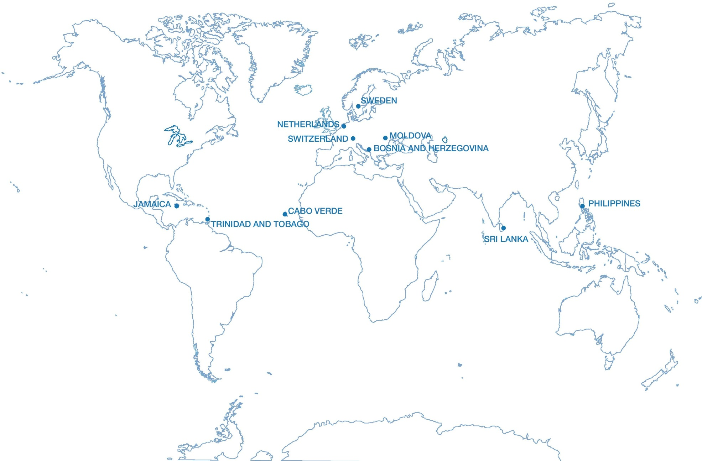
Dashboard operationalisation
10 pilot countries

Slide 4
How does the dashboard work?
5 policy dimensions
Promote institutional coherence
Reduce the costs of migration
Enhance the development impact of migration
Protect the rights of migrants and their families
Promote the (re)integration of migrants
1
2
3
4
5

Slide 5
Example indicators
DIMENSION 1 Promote institutional coherence for migration and development | origin/ destination | Nationally representative data on international migration is systematically collected through the country’s census, labour force survey (LFS) or other national surveys and is publicly available. 0 = no 5 = nationally representative data on migration are collected in country’s LFS, census and/or other national survey(s) = nationally representative data on migration are collected in the country’s LFS, census and/or other national survey(s) and are publicly available.
 |  | There is an inter-agency mechanism, e.g., a body or committee, that allows for the consideration of migration (and development) in other policy sectors. 0 = no mechanism, or those participating in mechanism have not met in last year 5 = mechanism exists and those participating in it have met once in last year 10 = mechanism exists and those participating in it have met more than once in last year
Notes:
Circled indicator – relevant to SDG target 17.18 (which mentions the availability of high-quality data)

Slide 6
Example indicators
DIMENSION 2 Reduce the costs of migrating | origin/ destination | There are no recruitment costs for migrants. 0 = recruitment fees exceed what is chargeable by law, or there is no law in place 5 = recruitment fees chargeable are limited by law 10 = there are no recruitment costs for migrants
 | origin/ destination | Recruitment fees for migrant workers are regulated by law. 0 = recruitment fees exceed what is chargeable by law, or there is no law in place 5 = recruitment fees chargeable are limited by law 10 = there are no recruitment costs for migrants
 | origin | Passport costs are less than X% of annual per capita income. 0 = no 5 = no, between X% and Y% 10 = yes, less than X%
Notes:
Circled indicator – relevant to SDG target 10.7 (on facilitating orderly, safe, regular and responsible migration)

Slide 7
Example indicators
DIMENSION 3 Protect the rights of migrants and their families | origin | Consular services in main destination countries include a special mechanism for protecting migrants’ rights (such as a labour attaché, social attaché or direct hotline). 0 = no, 10 = yes
 | destination | Migrants and their family members, regardless of status, have the same right to primary, secondary and tertiary education as citizens. 0 = no access 5 = access to primary and secondary education 10 = access to primary, secondary and tertiary education
Notes:
Circled indicator – relevant to SDG target 8.8 (on protecting labour rights)

Slide 8
Example indicators
DIMENSION 4 Promote the integration and re-integration of migrants | origin | Country has mechanisms (such as mutual recognition agreements) that promote (i) the recognition of degrees and skills from the origin country in destination countries and (ii) the recognition of degrees and skills gained abroad. 0 = no, 10 = yes
 | destination | There is a system for the recognition of foreign degrees and skills from countries of origin. 0 = no, 10 = yes
Notes:
Circled indicator – relevant to SDG target 10.7 (on facilitating orderly, safe, regular and responsible migration)

Slide 9
Example indicators
DIMENSION 5 Enhance the development impact of migration | origin/ destination | By 2030, the transaction costs of migrant remittances are reduced to less than 3 per cent and remittance corridors with costs higher than 5 per cent are eliminated. 0 = the average transaction cost for migrant remittances is 3 per cent or more 5 = the average transaction cost for migrant remittances is less than 3 per cent 10 = the average transaction cost for migrant remittances is less than 3 per cent and no corridor exceeds 5 per cent
 | origin/ destination | There are no restrictions or taxes on the inflow/outflow of remittances. 0 = there are taxes on the inflow/outflow of remittances 5 = there are restrictions other than taxes (such as capital controls) on the inflow/outflow of remittances 10 = there are no restrictions or taxes on the inflow/outflow of remittances
 | destination | Migrants’ pathway to citizenship or permanent residency is unaffected by temporary stays (of three months or less) out of the country. 0 = no 10 = yes
Notes:
Circled indicator – relevant to SDG target 10.c (on reducing the cost of remittances)

Slide 10
Presenting results
Two dashboards
  countries of origin
  countries of destination
Two methods for presenting results
  Radar charts
  Traffic lights

Slide 11

Presenting results
Option 1: Radar charts
Countries of origin
Countries of destination
Migrants’
(re)integration

Slide 12
Presenting results
Option 2: Traffic lights
Countries of origin
0 - 49 | 50 - 79 | 80 - 100
 | Institutional coherence | Reducing costs | Migrants’ rights | (Re)integration | Development impact
Country A
Country B
Country C
Country D
Country E
Notes:
Real data has been used for this table, based on the version of the dashboard that was circulated prior to the Geneva consultation meeting on 9 Sept.
Country A = Cabo Verde
Country B = Philippines
Country C = Trinidad and Tobago
Country D = Sweden
Country E = Switzerland
NB: normally, we would not compare these countries in the same table, as the first three are COOs whereas the last two are CODs.

Slide 13
Moving forward
Next steps
Oct 2015-Feb 2016
Expand operationalisation of dashboard to 20-25 countries
Jan 2016 – Jun 2016
Technical workshop on scoring/weighting
Nov/Dec 2016
Publication of report on dashboard operationalisation
Workshop on synergies between dashboard and SDGs
National workshops

Slide 14
Thank you
8th Global Forum on Migration and Development
Platform for Partnerships
Friday, 16 October 2015

