Slide 1
GMG MigratIOn and DEVELOPMENT DATA HANDBOOK
Frank Laczko, IOM and Bela Hovy, UNDESA
Co-Chair s GMG Data and Research Working Group.
Platform for Partnerships, Global Forum on Migration and Development, Istanbul, October 16th, 2015.
Notes:
Notes on bullet point 1: The inclusion of migration in the post-2015 SDGs means there will be an increased need and demand for better data from which progress towards the goals can be assessed against. Additionally, the inclusion of migration into the Post-2015 SDGs illustrates the nexus between migration and development is tightening, thus, data on the migrant population will need to be disaggregated from non migrant populations.
2.. There is wide recognition that official statistics on international migration are poor. Better data is needed for better evidenced based migration policies.

Slide 2
Background: HLD 2013 CALLS FOR BETTER Migration DATA
The Declaration of the High-level Dialogue on International Migration and Development:
Emphasized “the need for reliable statistical data on international migration, …and noted “migration data could facilitate the design of evidence-based policy and decision-making in all relevant aspects of sustainable development”.
No agreement on a global action plan; but GMG workplan include “providing guidance and support to States in collecting and analysing data on migration and development”.
Notes:
Notes on bullet point 1: The inclusion of migration in the post-2015 SDGs means there will be an increased need and demand for better data from which progress towards the goals can be assessed against. Additionally, the inclusion of migration into the Post-2015 SDGs illustrates the nexus between migration and development is tightening, thus, data on the migrant population will need to be disaggregated from non migrant populations.
2.. There is wide recognition that official statistics on international migration are poor. Better data is needed for better evidenced based migration policies.

Slide 3
Paucity of DATA ON MIGRATION Recognized
The 2009 “Migrants Count” report highlighted a lack of detailed, comparable, disaggregated data on migrant stocks and flows
Censuses main source of migration data but sometimes infrequent.
Data not timely or fully analysed.
UN 2013– “number of countries that could provide statistics on international migration flows remains extremely low”.
Notes:
Notes on bullet point 1: The inclusion of migration in the post-2015 SDGs means there will be an increased need and demand for better data from which progress towards the goals can be assessed against. Additionally, the inclusion of migration into the Post-2015 SDGs illustrates the nexus between migration and development is tightening, thus, data on the migrant population will need to be disaggregated from non migrant populations.
2.. There is wide recognition that official statistics on international migration are poor. Better data is needed for better evidenced based migration policies.

Slide 4
Since 2009 GLOBAL CONTEXT HAS CHANGED
New data sources - growing recognition of the importance of “Big Data”.
The High Level Panel of Eminent Persons on the post-2015 development agenda calls for a “development data revolution” .
Migration now included in SDG framework – how will migration be monitored globally, regionally and nationally ?
Notes:
Points for elaboration: The High Level Panel, was followed, in 2014, by a UN advisory group on a ‘ Data Revolution for Sustainable Development’. A report was produced that followed up on the above definition, calling for more diverse, integrated, timely and trustworthy information. However there is a danger that the need for better data on migration and migrants may be overshadowed by those advocating for a development data revolution.
The dangers come from the fact that whilst there is a strong nexus between migration and development in academia, and at the international and national level, there is still a separation in practice, particularly at the national level.

Slide 5
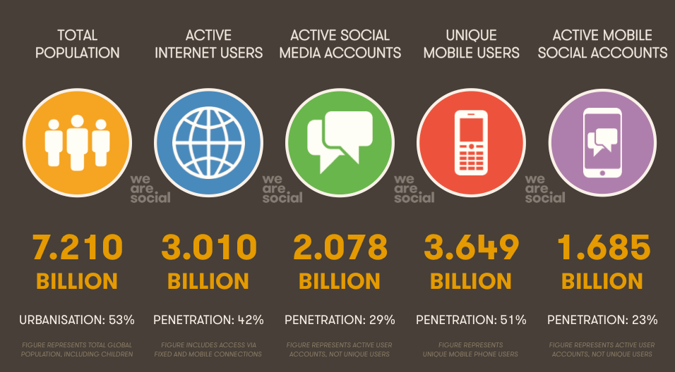
The global ‘data revolution’
Notes:
90% of data that exists in the world today was created just over the past two years…

Slide 6
A World That Counts – report of data revolution group, 2014.
“Ultimately, the better the data available in the development field, the higher the quality of people’s lives in poor countries”. (Bill Gates, 2013).
Whole groups of people are not being counted
Growing inequalities in access to data
Existing data remain unused
Volume of data increasing exponentially
Notes:
Notes on bullet point 1: The inclusion of migration in the post-2015 SDGs means there will be an increased need and demand for better data from which progress towards the goals can be assessed against. Additionally, the inclusion of migration into the Post-2015 SDGs illustrates the nexus between migration and development is tightening, thus, data on the migrant population will need to be disaggregated from non migrant populations.
2.. There is wide recognition that official statistics on international migration are poor. Better data is needed for better evidenced based migration policies.

Slide 7
Migration and the SDGs
Migration included in the 2030 Agenda for Sustainable Development.
Several references to remittances, trafficking, and need for “orderly, planned and well-managed” migration policies, etc.
“Nobody should be left behind”– including migrants - data should be disaggregated according to migratory status.
Difficult to measure progress towards goals/targets unless you have reliable, consistent, and comparable statistical data
Notes:
Notes on bullet point 1: The inclusion of migration in the post-2015 SDGs means there will be an increased need and demand for better data from which progress towards the goals can be assessed against. Additionally, the inclusion of migration into the Post-2015 SDGs illustrates the nexus between migration and development is tightening, thus, data on the migrant population will need to be disaggregated from non migrant populations.
2.. There is wide recognition that official statistics on international migration are poor. Better data is needed for better evidenced based migration policies.

Slide 8
Handbook Objectives
Provide practical guidance to policymakers and practitioners on the measurement of international migration and its impact on development.
Bring together in one place the collective experience of the GMG.
Highlight and share information on innovative practices and lessons learned.
Notes:
Notes on bullet point 1: The inclusion of migration in the post-2015 SDGs means there will be an increased need and demand for better data from which progress towards the goals can be assessed against. Additionally, the inclusion of migration into the Post-2015 SDGs illustrates the nexus between migration and development is tightening, thus, data on the migrant population will need to be disaggregated from non migrant populations.
2.. There is wide recognition that official statistics on international migration are poor. Better data is needed for better evidenced based migration policies.

Slide 9
SCOPE
Contributions from 15 GMG agencies
Broad range of themes – 16 chapters
Divided into 4 key sections
Notes:
Notes on bullet point 1: The inclusion of migration in the post-2015 SDGs means there will be an increased need and demand for better data from which progress towards the goals can be assessed against. Additionally, the inclusion of migration into the Post-2015 SDGs illustrates the nexus between migration and development is tightening, thus, data on the migrant population will need to be disaggregated from non migrant populations.
2.. There is wide recognition that official statistics on international migration are poor. Better data is needed for better evidenced based migration policies.

Slide 10
Handbook STRUCTURE
16 chapters using common template
Key policy issues – introduction to theme.
Data needed to analyse the topic
Existing standards and sources for data collection
Examples of good practice
Recommendations to address data gaps

Slide 11
BENEFITS OF USING THE Handbook
Summarizes existing standards and definitions for the collection of migration data.
Provides an international overview of the main sources of migration data and inventory of existing data.
Provides examples of good practice for the collection of migration data and their use in policy-making.
Assesses the progress that has been made in implementing global standards and guidelines.
Summarizes key recommendations that countries should follow when collecting migration data.

Slide 12
SOME LESSONS LEARNED
Several examples of innovative practices which could be potentially replicated.
New data sources such as “Big Data” yet to be fully exploited by GMG and States, although several innovative examples.
Data guidelines lacking in several policy fields including, migrants in crisis situations, stranded migrants, migrants in detention, etc.

Slide 13
WAY FORWARD: NEXT STEPS
How to ensure that the handbook is widely read and used ?
GMG data training courses ?
Development of training modules
Create database of tools/links to data guides and practices.
Pilot projects to test handbook and assess data capacities ?

Slide 14
Concluding Remarks
The 2030 Agenda has placed statistics development at the centre of the global development agenda.
It is essential that migration data are mainstreamed into national development data plans.
The GMG Migration and Development Data Handbook can contribute to this effort.

