Slide 1
Global Forum on Migration and Development: Platform for Partnership
Gender Mainstreaming Migration and Development
Dr. Jenna Hennebry
jhennebry@wlu.ca
Jenna Holliday

Slide 2
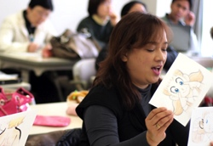

Slide 3
Gender on the Move:
A Toolkit For Reflexive Policy Development And Implementation From a Gender Perspective
http://www.unwomen.org/en/digital-library/publications/2013/12/gender-on-the-move

Slide 4
Thank you!

